Slide 1

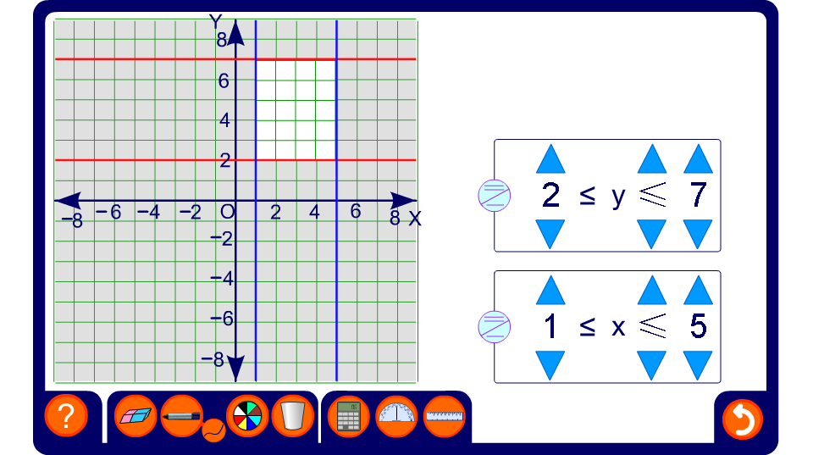


Horizontal and vertical regions combined

